Slide 1
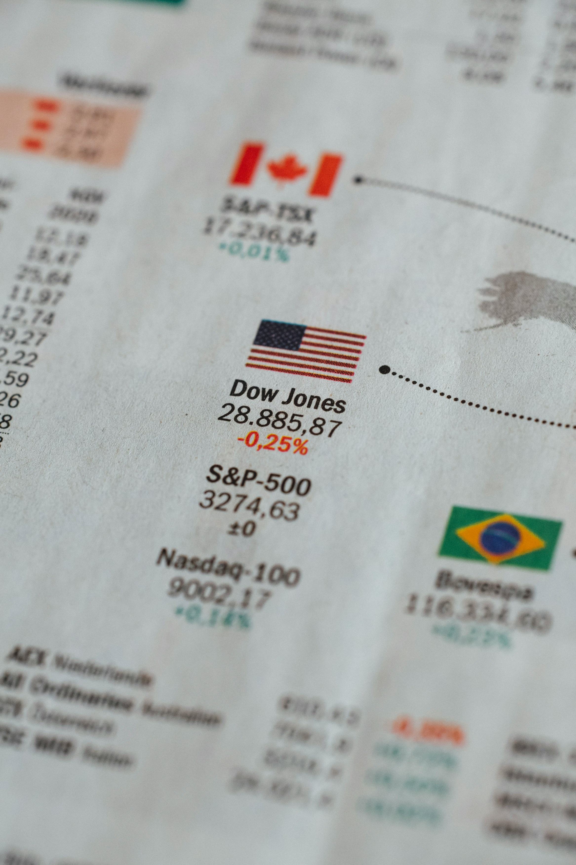

PROJECT 2
UNC AI Bootcamp
Predicting Covered Call Options on SPY using Machine Learning
GROUP 3:
Yeongjin Nam
Mat Nicholas
Nee Buntoum
Jana Avery
Jay Requarth
Dr. Dick Davis
John Andrews

Slide 2


The Problem Statement
Investors like retirees face optimizing covered call strategies to protect their investments and create ongoing revenue.
Some investors use covered calls to generate income from their portfolios while preserving capital and limiting downside risk.
The goal of this project is to use machine learning to answer the question on whether or not this is a viable strategy and if so, help investors maximize their returns.

Slide 3

Let’s use
a lemonade stand analogy to understand covered calls.
Lemonade Stand Story:
Imagine you own a small lemonade stand that you believe is worth $100. One sunny day, a neighbor comes to you and says,
“I see you’re doing well with your lemonade stand. I’d like to have the option to buy it from you for $100 next month because I think it will be worth more by then. I’ll pay you $10 right now for that option.”

Slide 4
You get to keep the $10 no matter what…
If your neighbor decides to buy the lemonade stand for $100, you’ve made a bit of proﬁt (the $10 option fee).
If your neighbor decides not to buy the stand because it's not worth more than $100, you still keep your stand and the $10.

Slide 5

Why Covered Calls?
Covered calls are a smart way for stock owners to make extra money without having to sell their stocks. Imagine you own a piece of a company and think its value won't change much soon.
This strategy is perfect for people who want to keep their stocks for a long time and are okay with making a bit of money even if the stock doesn't go up much. It's a cautious way to earn from your investments without expecting big surprises in the stock's price.

Slide 6
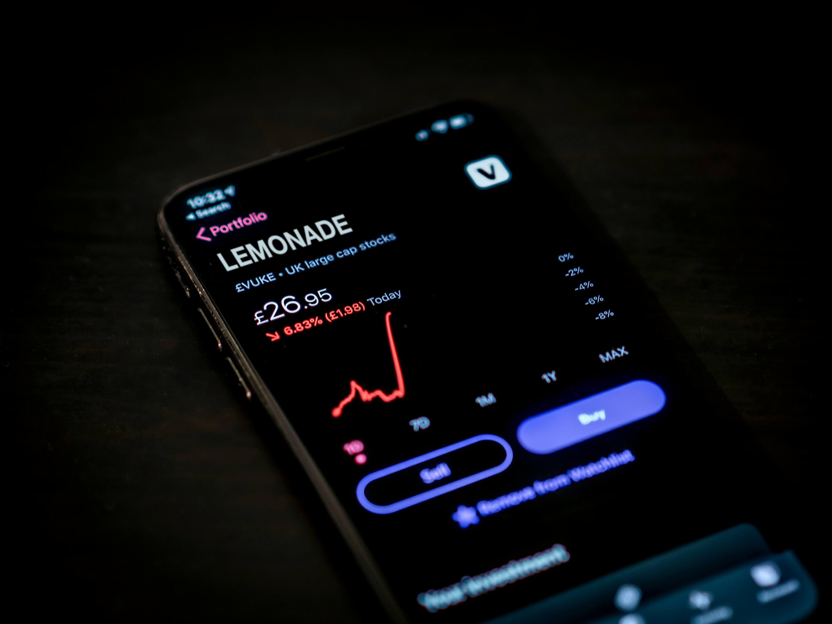
This situation is similar to selling a covered call in the stock market.
The $10 payment is the option premium that an option buyer pays you, the stock owner, for the right (but not the obligation) to buy your stock at a predetermined price (the strike price, in our analogy, $100) within a certain period.
The lemonade stand is like your stock.

Slide 7

AI to the Rescue
Our AI project tackles the complexities of the covered call investment strategy, offering a smarter, AI-driven solution for investors, especially retirees, looking to generate income without selling their stocks. Here's how:
AI simplifies choices by quickly analyzing data to identify the best stock options and call strategies, removing guesswork.
It enhances risk management by evaluating potential risks and returns from historical trends, helping investors make informed decisions.

Slide 8

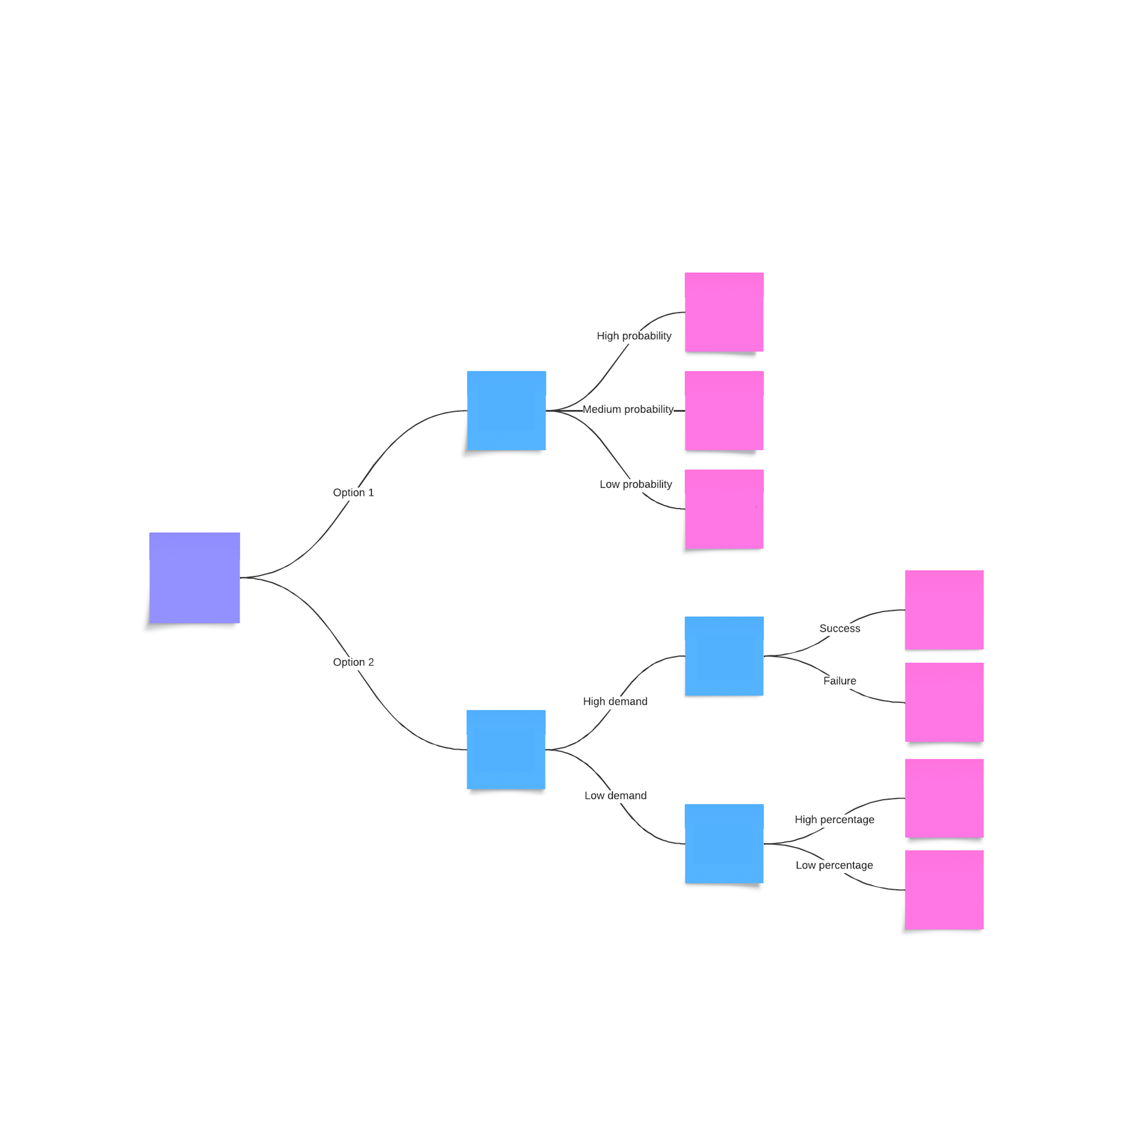
Choosing the right AI model is akin to selecting the best path in a complex maze. Our approach is methodical, guided by a decision tree that weighs various probabilities and demands against expected outcomes. Here's our rationale:
Assessing Probabilities
Demand Analysis
Success Metrics
Quantitative Rigor
Iterative Refinement
Outcome-Focused

Slide 9

OUR SOLUTION:
AI-Powered Covered Calls Service
We propose to develop an AI-driven service that simplifies and optimizes the covered call strategy for individual investors, mainly targeting retirees seeking to enhance their income. Our AI system will analyze vast amounts of stock and options data in real time, recommending the most promising covered call opportunities based on the individual's portfolio, risk tolerance, and income goals.

Slide 10
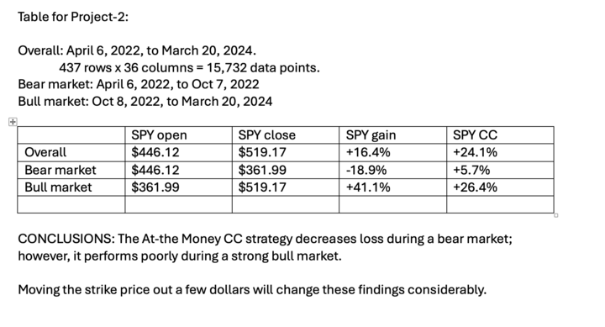
Optimizing Covered Call Strategies with AI
Data Integration
Beginning our journey with robust data integration, we harness real-time market insights from reputable sources. Our dedicated API key from Polygon.io serves as a gateway to the latest financial data, laying the groundwork for informed AI analysis.
Key Insights:
At-the-Money CC strategy mitigates downturns but may underperform in a strong bull market.
Adjusting strike prices could significantly influence these results.

Slide 11
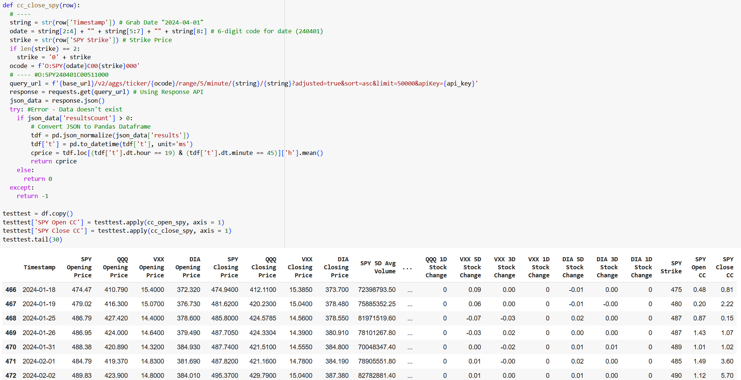
Scraping Data from polygon.io
Finding the correct data for our model proved challenging, given the limits of our access to our dataset.

Slide 12
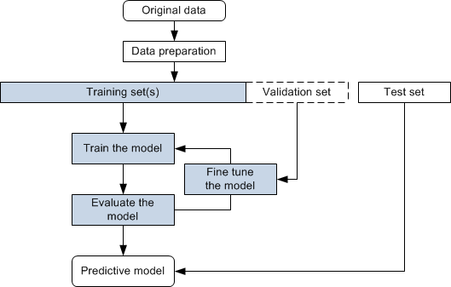
Data Preparation
Feature Engineering
Developed a target variable, 'trade,' to identify optimal trading days based on market movement predictions. This was complemented by rolling window calculations for short-term market trend analysis.

Slide 13
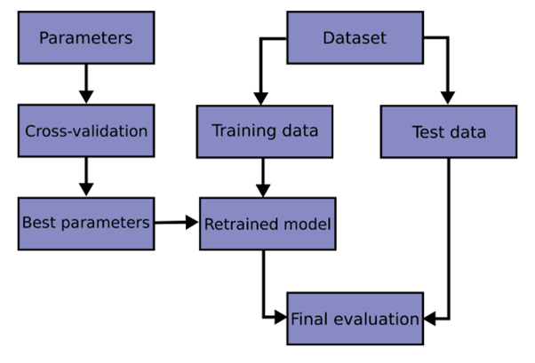
Validation Approach
Selectivity is key in feature selection. We sieve through our data, weighing the relevance of each factor against the scale of covered call strategy success. It's a blend of correlation and machine intelligence that determines the features with foresight.

Slide 14
Optimization Process
Considering the iterative nature of AI learning and the significance of market events in guiding AI evolution, a flowchart would be the most suitable visualization. This flowchart will visualize the continuous cycle of learning from past data, using market events as milestones for adjustment, and aiming towards predictive precision with the aid of before-and-after snapshots.

Slide 15
Data Methodology Overview
Sourcing Excellence
Outline the high-quality sources of your data, emphasizing the reliability and real-time nature of your data streams. Mention the use of Polygon.io API for the latest market data.
Data Transformation
Briefly describe the steps taken to clean and prepare the data for analysis, such as handling missing values, adjusting closing prices, and feature engineering.
Analytical Rigor
Summarize the analytical methods used to process the data. Highlight the use of time-series analysis to avoid look-ahead bias and the application of machine learning algorithms to identify trading signals.
Modeling Wisdom
Explain how various models were trained, tested, and selected, and touch upon the importance of scaling data to ensure model accuracy.
Outcome-Driven
Conclude with how the data methodology leads to actionable insights and decisions, underpinning the model’s predictions and the overall project’s goal to assist in covered call trading decisions.

Slide 16
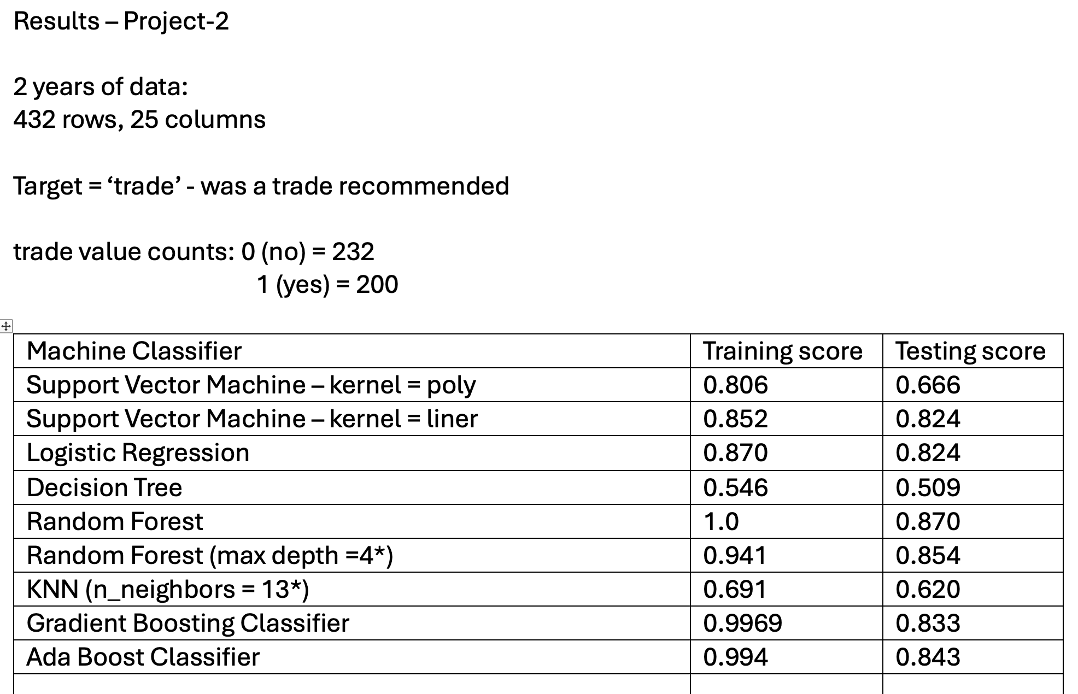
Presentation Summary
In our quest to optimize trade recommendations for covered calls, we've harnessed two years of data, funneling it through a series of machine learning classifiers. Here’s how they stacked up:

Slide 17
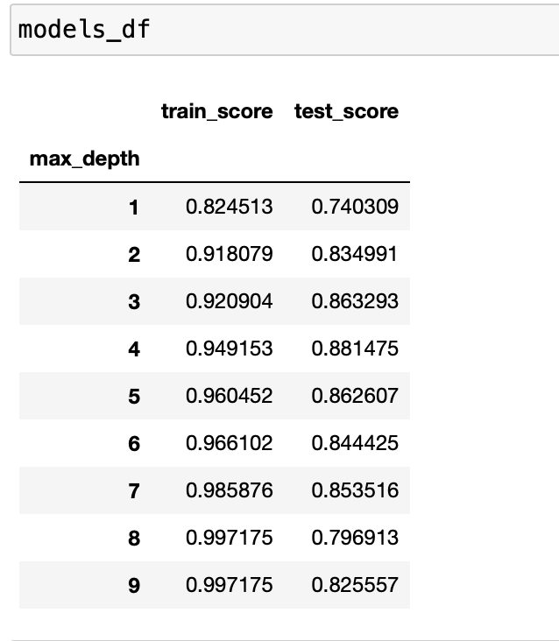
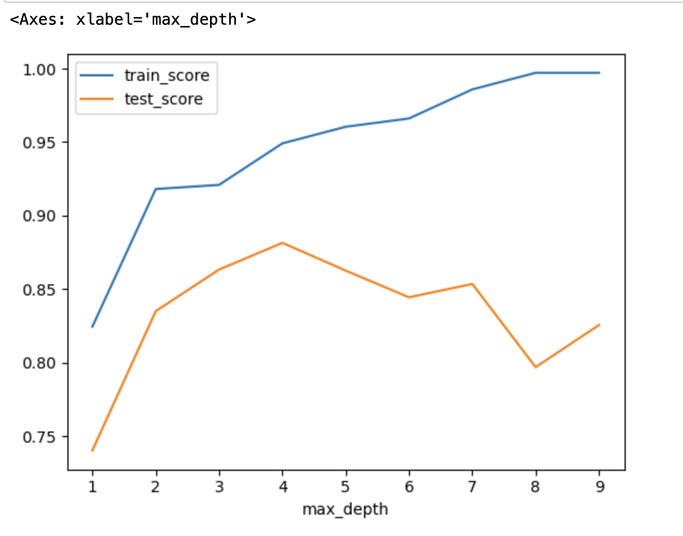
Presentation Summary
Parameter optimization for the Random Forest classifier model.

Slide 18
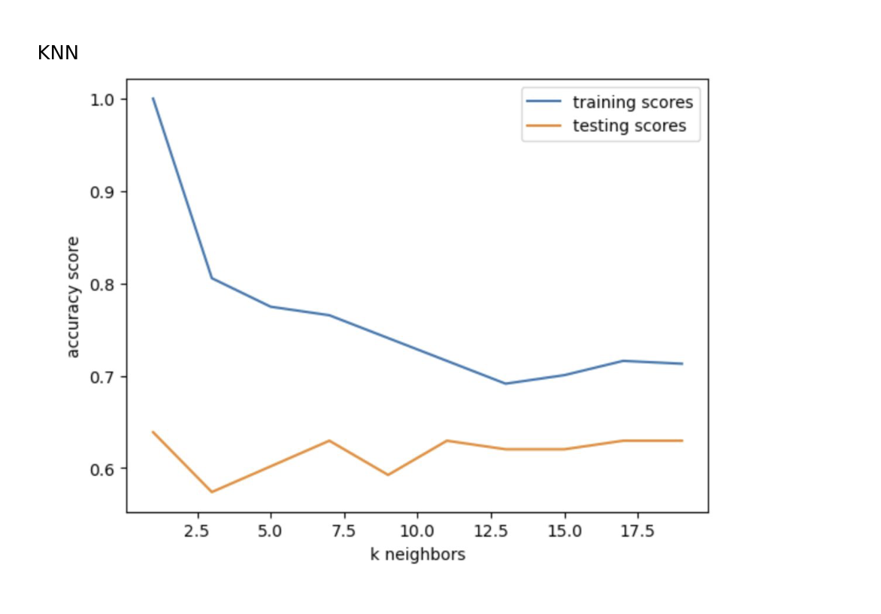
Presentation Summary
Parameter optimization for the KNN classifier model.

Slide 19
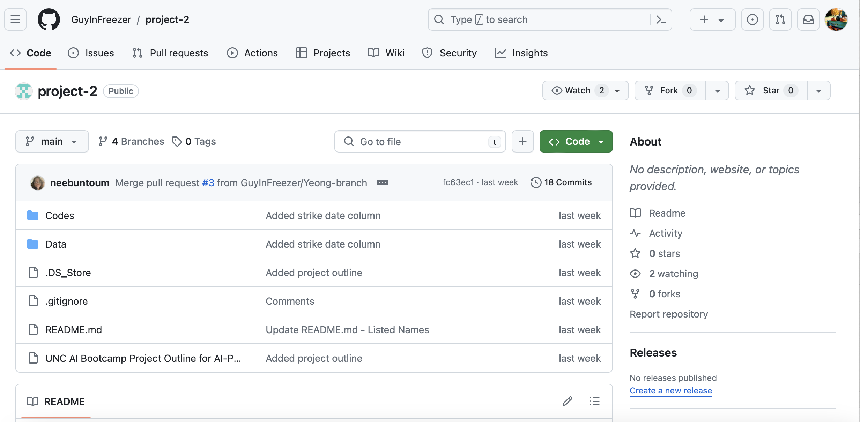
GitHub Repository Management
Our GitHub repository is a testament to our organized collaboration. It's the digital blueprint of our project, where code meets clarity, and documentation weaves the story of our development journey.
https://github.com/GuyInFreezer/project-2

Slide 20
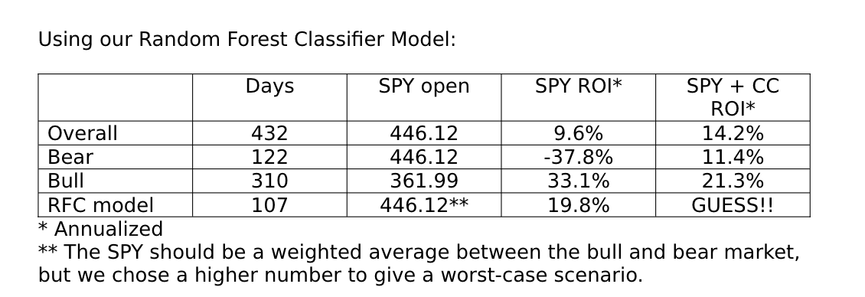
Results & Insights

Slide 21
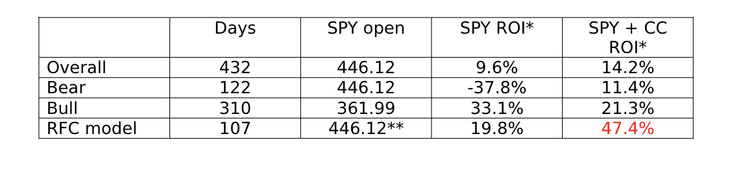
Results & Insights

Slide 22


Presentation Summary
Today, we unveiled an AI-driven approach to optimizing covered calls, providing investors with a strategic edge. Here's the essence of our journey:
In conclusion, our AI model stands as a beacon, guiding retirees through the complexities of the stock market towards a horizon of steady income.
Data-Driven: Our rigorous data collection from Polygon.io set the stage for accurate analysis.
Day 0 Focus: Concentrating on 'Day 0' SPY covered calls, we've crafted a daily strategy for consistent income.
Methodical Analysis: We processed and engineered features from over two years of market data, ensuring a robust model foundation.
Precision Modeling: By optimizing models like Random Forest and KNN, we achieved a nuanced understanding of when to execute trades.
Proven Results: The models demonstrate promising strategies, reducing losses in bear markets and capturing gains in stable conditions.
Next Steps: Our path forward includes refining models and exploring dynamic strike price adjustments.

